Slide 1
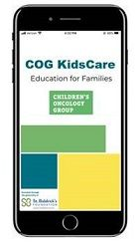
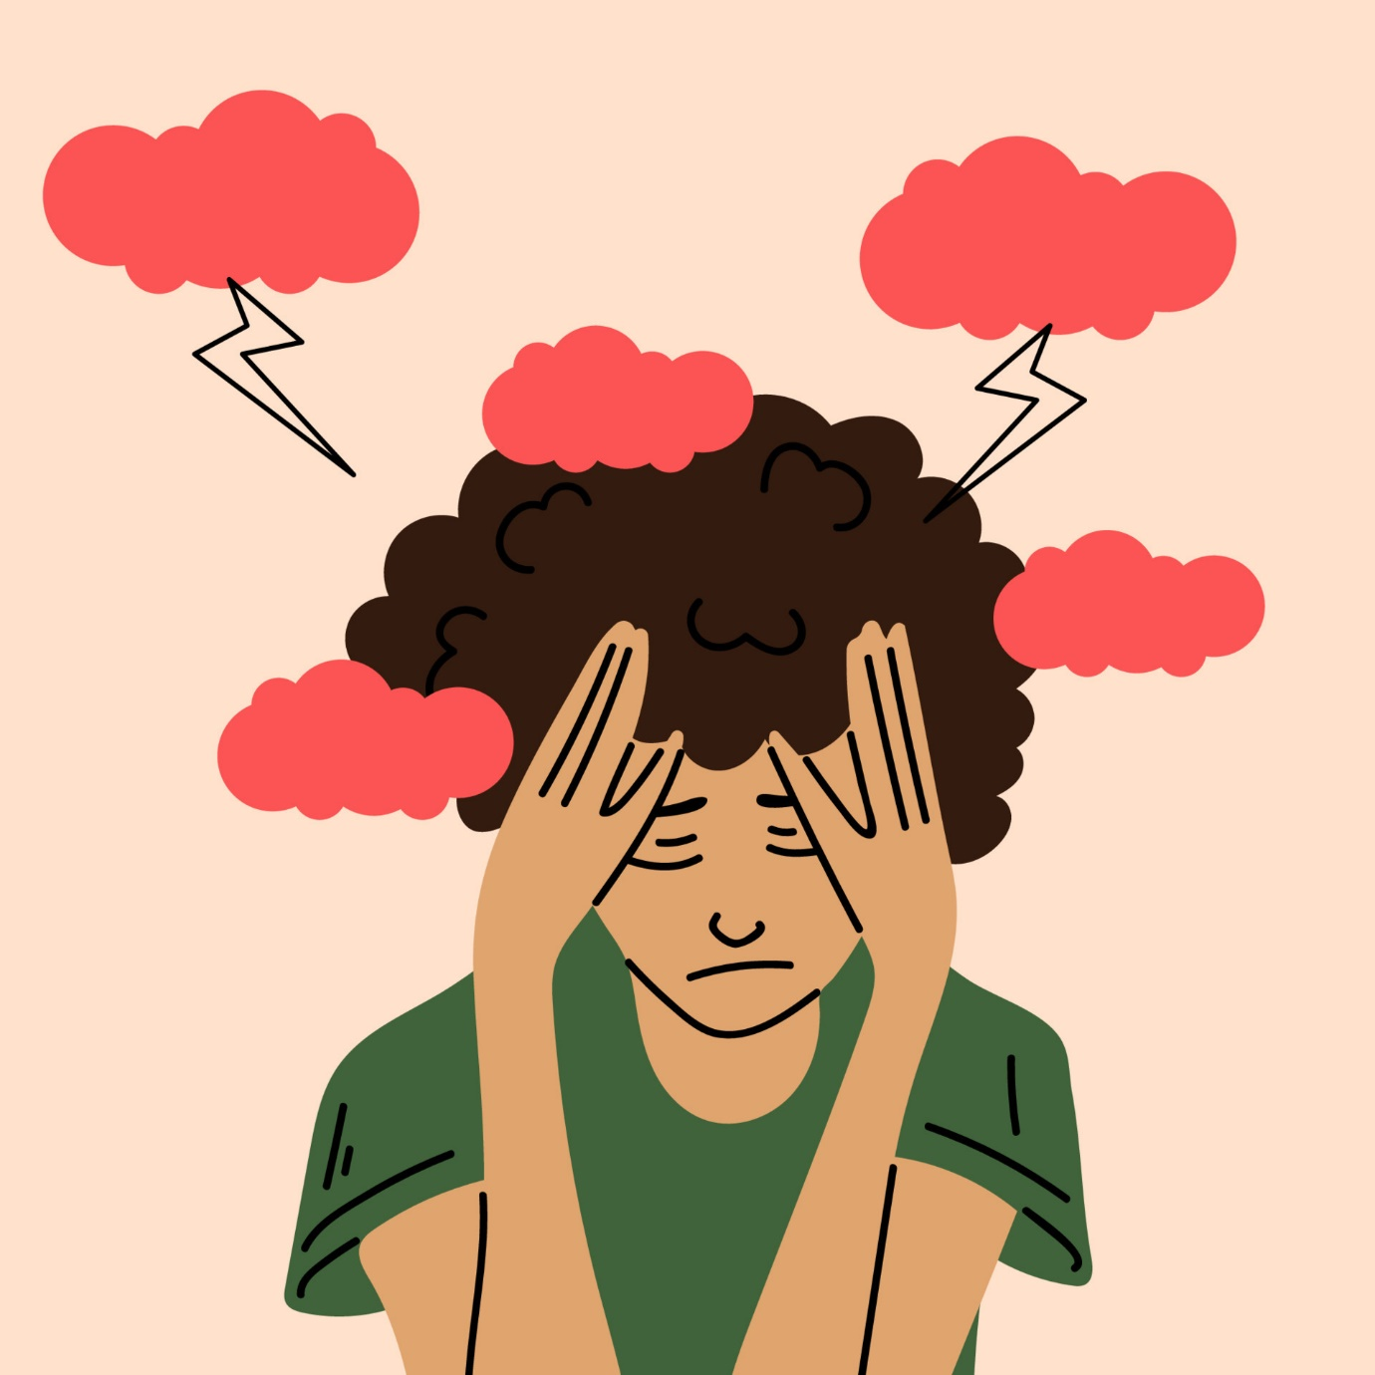
impact of cog kidscare app on caregiver stressors
Anne Marie Webster, MSN, CPNP, PMHS; Dr. Holly Tenaglia, DNP, APRN; Dr. Kelli Garber, DNP, APRN; Dr. Jacqueline Kraveka, DO
Macon & Joan Brock Virginia Health Sciences Ellmer School of Nursing at Old Dominion University, Norfolk, VA
Methods
Background
Sample
Discussion
Cancer, after infancy, remains the leading cause of death from disease for children in the United States.
Caregiver stress results from the cancer diagnosis as well as becoming the child’s medical expert and advocate.
Post-traumatic stress, anxiety, and depression are common caregiver themes independent of the diagnosis or the child’s prognosis.
Convenience sample of pediatric cancer caregivers at the Medical University of South Carolina
Pre-survey/post-survey design after use of App:
Demographic data
Perceived Knowledge Scale (investigator-created scale)
Anxiety Scale (GAD-7)
Self-Efficacy for Caregiving Scale
Statistically significant inverse correlation between self-efficacy and anxiety suggesting the value of initiatives which directly empower caregivers specific to their child's medical needs
No statistically significant difference in pre/post levels of perceived knowledge, anxiety, or self-efficacy with App use, but limited sample size
Caregiver feedback included the need for a single way to access to all child’s information that links to medical records, is user-friendly, and is easily accessible
Implications
Future research should highlight ways to increase levels of self-efficacy that are beneficial for the caregiver and respectful of their many responsibilities during cancer treatment.
Mobile Apps warrant further investigation as they can be customized and are a readily available tool, caregiver feedback is crucial in the development of these resources
References *additional references available upon request ​
​
Bernier Carney, K. M., Stegenga, K., & Linder, L. A. (2022). Informing parents as caregivers with ​
a symptom assessment app developed for children with cancer. Journal of Pediatric ​
Hematology/Oncology Nursing, 39(4), 264-272. ​
https://doi.org/10.1177/27527530211073307​
​Children’s Oncology Group. (2023). COG patient and family resources: COG KidsCare ​
App.https://childrensoncologygroup.org/docs/default/source/ pdf/cog_​
kidscare_app_flyer_for_parents_eng_span_fr.pdf?sfvrsn=c14d09ee_2
Demographics | N=33 (%)
Age 20-30 31-40 41-50 51-60 | 6 (18.2) 9 (27.3) 13 (39.4) 5 (15.1)
Relationship Parent Grandparent | 33 (97) 1 (3)
Diagnosis Leukemia Lymphoma Brain Tumor Neuroblastoma Other | 15 (45.5) 2 (6.1) 5 (15.2) 5 (15.2) 6 (18.2)
Age of Cancer Patient 1-5 6-10 11-15 16-24 | 10 (30.3) 6 (18.2) 7 (21.2) 10 (30.3)
Number of Months since Diagnosis 2-12 13-24 25-36 37-48 49-60 >60 | 9 (27.3) 7 (21.2) 7 (21.2) 4 (12.1) 2 (6.1) 4 (12.1)
Time to treatment center Less than 30 min 30 min-1 hour 1-2 hours >2 hours | 4 (12.1) 10 (30.3) 10 (30.3) 9 (27.3)
Results
Statistically significant inverse correlation with anxiety and self-efficacy, (<0.001 p<0.01)-Spearman’s Rho
No statistical differences in pre-post scores for perceived knowledge (0.781, p>0.05), anxiety (0.577, p>0.05), or self-efficacy (0.865, p>0.05)-Mann-Whitney U.
No caregivers had previously heard of/used COG Kids Care App
Majority of caregivers travel 30 min-2 hours for care
Anxiety levels average in moderate range (moderate anxiety 10-14)
Purpose
Sample
To evaluate
Common caregiver stressors
The utility of a mobile App, the Children’s Oncology Group Kids Care App on those stressors
Scale | Range | Mean Pre | Mean Post | Statistical Difference
Perceived Knowledge | 1-7, higher indicates increased knowledge | 4.02 | 3.96 | .99%
Anxiety | 0-21, higher indicates increased anxiety | 13 | 12 | 1.08%
Self-Efficacy | 1-8, higher indicates increased SE | 7 | 7.16 | .98%
Research Questions​
RQ1: Is there a correlation between caregiver perceived knowledge, anxiety level, and level of self-efficacy?​
RQ2-4: Is there a significant difference in caregiver perceived knowledge level (RQ2), anxiety (RQ3), self-efficacy (RQ4), regarding their child’s cancer diagnosis following implementation of the COG KidsCare app?
​
Figure 2 Caption:
Limitations
Small sample size (Pre-survey n=33, Post-survey n=7)
Unable to link pre/post survey participants
Few number of participants used App
Lack of feedback specific to the COG KidsCare App to make recommendations
Acknowledgements can go here
Acknowledgment: Medical University of South Carolina

